Slide 1
Sprint 5 Deliverable
Team Yellow
Janet Gregoire, Dakota Kronberger, & Nicholas Roush

Slide 2

Steam Platform™
Steam is a popular gaming platform. You can buy games from the Steam marketplace, give games to people as gifts, and play games within the Steam application.
Items are collected in various games, and users collect these items either automatically when playing the respective game, or by performing various in-game tasks/micro-transactions.
Among these items are Trading Cards, which belong to every game. Cards are dropped when the user plays the game for a specific amount of time.
Each game has a full set of trading cards (between 5-10 cards). When the user collects all trading cards for a certain game, he/she can combine all the cards into a Steam badge.
Each time a user gets a new badge, they get points towards their Steam profile, which they can use to unlock new showcases on the profile itself (such as item showcase/screenshot showcase).
However, a user may not want to play hours upon hours of a certain game just to get all cards. Steam has a built-in trading system to allow users to trade items between one another.

Slide 3
Purpose of Steam Trading Application
With our application, the user can make "Posts".
A post is basically an advertisement, saying that "User A" has "Card A", and "User A" is looking for an anonymous/unknown "User B" that has "Card B"
For example:
I am User A. I have 4/5 trading cards for a game.
I am User B. I have 4/5 cards for a different game.
User A has the card that User B needs, and vice versa.
User A puts up a "post", or an advertisement, saying that he is looking for Card B, and he will trade Card A for Card B.
User B finds this advertisement, and proceeds to contact User A to make the trade happen.

Slide 4
Why would someone use this application?
If a user knows exactly what card they need, they can find someone else who has that exact card.
If a user wants to get rid of extra cards they have, they can make posts with their respective cards.
Without a tool such as this one, how would anyone find another user with the card/item that they need?

Slide 5
Multi-Sprint Plan
Sprint 1 - Complete a mockup of the application, ERD, and class diagram.
Sprint 2 - Create a working database. The program will have the ability to create posts and edit them. The posts will be saved to the database to be used later.
Sprint 3 - Create framework for editing data sets, one-to-one data sets, one-to-many data sets, and many-to-many data sets.
Sprint 4 - Validate data using data binding and built-in validation features. Validate data using appropriate user interface control types. Implement paging of data. Implement sorting of data. Implement searching of data
Sprint 5 – Query the database for an object based on user input. Export reporting in a presentable format.

Slide 6
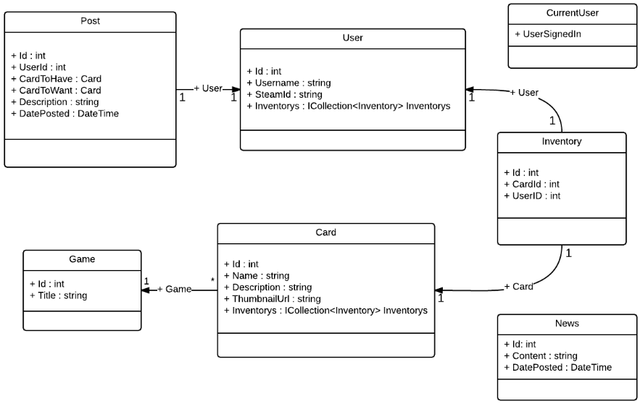
Class Diagram

Slide 7
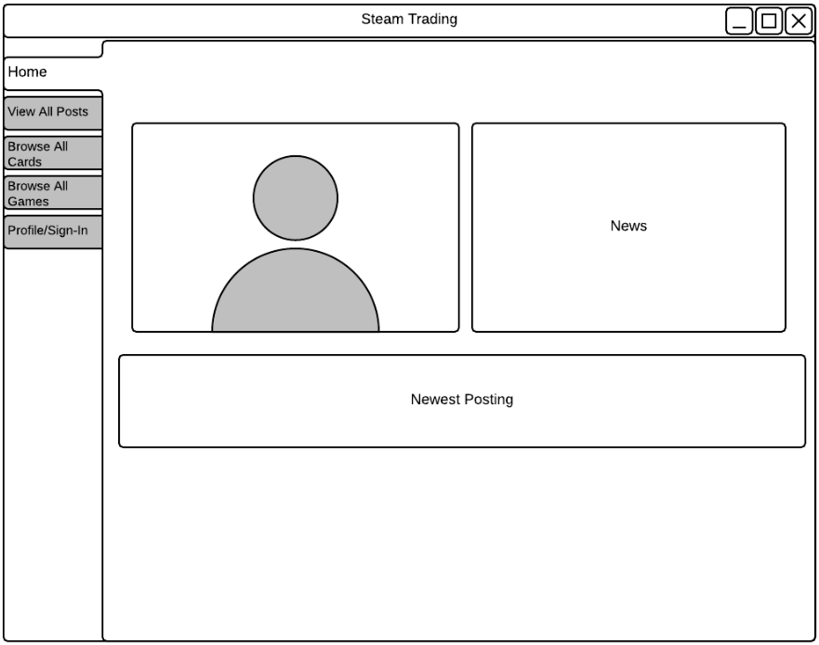
Mockup: Home

